Slide 1
Quant Research Rapid Prototyping Library
Fall 2018 Midpoint Presentation
Date 12/3/18
Team: sdmay19_06
Advisor: Srikanta Tirthapura
http://sdmay19-06.sd.ece.iastate.edu/
Notes:
Please fill in all information on this slide. Do not add or remove any fields.

Slide 2
Meet the Team
Josiah Anderson
DohYun Kim
Gabe Klein
Drake Mossman
Jacob Richards
Nathan Schaffer
2
sdmay19_06: Quant Research Library
Notes:
As indicated in the slide, format team members’ pictures into circles.

Slide 3
Introduction
Project Pan
Agenda
System Design
Conclusion
3
sdmay19_06: Quant Research Library
Notes:
This is the standard agenda slide. As you are building your presentation, use the agenda slides to guide the structure and section breakdown of the presentation. Use no less than four sections and no more than six. Additionally, adjust the icons in the circle (slides containing additional icons can be found later in the template) to fit the theme of your presentation sections.

Slide 4
Introduction
Project Plan
Agenda
System Design
Conclusion
4
sdmay19_06: Quant Research Library
Notes:
This serves as a transition into your first presentation section.

Slide 5
Problem Statement
So what’s the problem..?
Quant research at Principal Financial involves a system of core process which are not automated or connected efficiently. As a result, the outputs of these processes display a lot of variance and inconsistency. This project hopes to automate a pipeline for the Dynamic Risk Premium 2.0, which is one such Quant process.
Why is this a Problem?
1
2
3
Disjointed Projects
Inefficiency
Sustainability
5
sdmay19_06: Quant Research Library
Notes:
Please fill out and include this slide at the beginning of your first section.

Slide 6
Problem Statement
How did we get here?
“Quant Research Rapid Prototyping Library”
What?
How?
Analysis and Interviews
Data Aggregation
Process Standardization
Dynamic Risk Premium 2.0
Manageable Scope
Clear Direction
Quant Research
DRP 2.0
sdmay19_06: Quant Research Library
Notes:
Additional notes:
Keep the positioning of your subtitles consistent throughout the slide deck.
Make sure every slide has a slide number, classification, and Principal logo. Keep the location of these fields consistent throughout the slide deck.

Slide 7
System Description
What is the Dynamic Risk Premium 2.0?
Based off of the Dynamic Risk Premium
DRP 2.0 focused on increased modularity and transparency
Modules vs. Magic
Uses stock level data to create and evaluate models to predict future returns on individual stocks
Multiple student teams across the nation are working on the modules of DRP 2.0
Our deliverables:
Create a pipeline in the form of a library of functions
Standardized API documentation
sdmay19_06: Quant Research Library
Notes:
Operating environment

Slide 8
Introduction
Project Plan
Agenda
System Design
Conclusion
8
sdmay19_06: Quant Research Library
Notes:
This serves as a transition into your second presentation section.

Slide 9
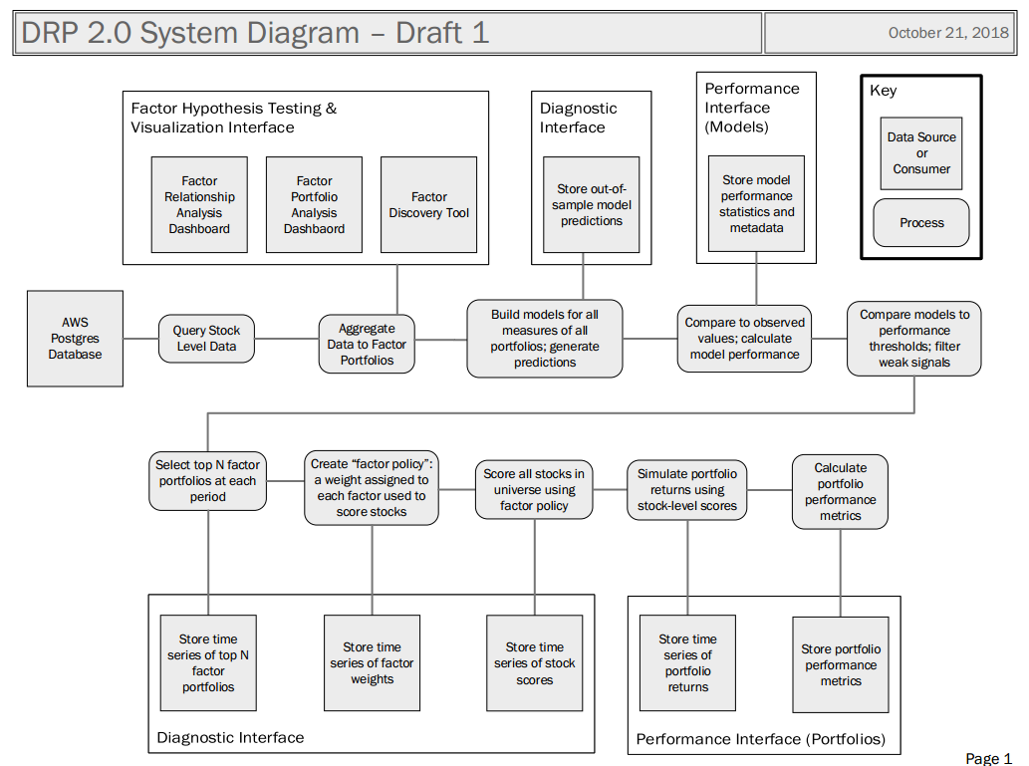
System Block Diagram
sdmay19_06: Quant Research Library
Notes:
Additional notes:
Keep the positioning of your subtitles consistent throughout the slide deck.
Make sure every slide has a slide number, classification, and Principal logo. Keep the location of these fields consistent throughout the slide deck.

Slide 10
Functional Requirements
Our DRP 2.0 Pipeline
The pipeline will consume raw stock level data from an AWS Postgres database
The pipeline will be able to aggregate data to factor portfolios
The pipeline will be able to build models on factor portfolios, generate predictions, and calculate model performance
The pipeline will be able to score stocks using a factor policy
The pipeline will be able to simulate portfolio returns
Users will be able to customize the stock universe, factor portfolio strategies, model algorithms, and factor policy of the DRP 2.0 pipeline
Each function of the pipeline shall be able to be called and run independently
The pipeline will be able to handle missing or invalid stock level data
It will be able to interface with the DRP 2.0 dashboards
It will be able to run in both Python and R
sdmay19_06: Quant Research Library

Slide 11
Non-functional Requirements
Our DRP 2.0 Pipeline
(Performance) The pipeline will be able to handle up to several GB of data
(Performance) The pipeline should be able to handle millions of observations and hundreds of factors
(Maintainability) The pipeline will have documented and standardized inputs and outputs for each of its functions and interfaces
(Usability) The pipeline interfaces will be intuitive to a novice data scientist
(Accessibility) The pipeline will be useable by novice programmers
(Security) The pipeline will not leak confidential data to outside sources
(Compatibility) The pipeline will be able to perform the same functionality as provided existing scripts
sdmay19_06: Quant Research Library

Slide 12
Constraints and Considerations
The data scientists on the Principal team are most familiar with writing scripts in R and Python.
Our project will need to be able to interface with one or both of these languages.
As our project is software based and is mostly local, there are minimal safety and security constraints to address.
sdmay19_06: Quant Research Library
Notes:
Be smart with your SmartArt.

Slide 13
Market Survey
Are there products like this already?
Quantopian
Python Library for quantitative data analysis
Many useful functions with good documentation
Some free functionality, but also subscription based
Caret
Open source package for R
Streamlines standard tasks in the creation of predictive models
Not specific to the financial sector
Broader functions, with thorough documentation
Principal already uses Caret in some of their research
Quantiacs
Library for quantitative data analysis
Can be used in Python or Matlab
Very similar to Quantopian
Less access to user documentation
sdmay19_06: Quant Research Library
Notes:
How will the results of your project make an impact going forward? Please include some representation of this information in the final section of your presentation. This is just one example.

Slide 14
Potential Risks & Mitigation
Significant misunderstandings of DRP 2.0 requirements
HIGHEST
A Power BI dashboard doesn’t
interface with our library
SIGNIFICANT
Python library can’t easily be ported to R package
MODERATE
Mitigation Strategy:
Active feedback with Principal throughout development
Mitigation Strategy:
Interact with the dashboards early next semester
Verify interface understanding
Mitigation Strategy:
Thorough investigation of limitations to R wrapper
Avoid incompatible Python code
sdmay19_06: Quant Research Library

Slide 15
Resource Requirements
Technical:
Other:
Access to Principal’s AWS server
Bloomberg and Factset data
ETG server to be used for continuous integration tests
Travel costs
Parking and gas for meetings in Des Moines
Time cost
Meetings in Des Moines consume at least 3+ hours
sdmay19_06: Quant Research Library
Notes:
AWS, factset/Bloomberg, ETG server for testing

Slide 16
Milestones
Key moments from this semester​
Midpoint Presentation
Presented our findings for department heads at Principal Financial
Faculty Presentation
All documents and semester deliverables have been prepared.
Project Start
Kickoff meeting with Principal
October 15th
Nov. 28th
August 24th
Oct. 26th
Dec. 3rd
User Interviews
Concluded the interview and analysis process
Final Meeting
Presented Project Plan and Design Document to Principal Financial
sdmay19_06: Quant Research Library
Notes:
This is the preferred method for displaying the timeline of your project.

Slide 17
Introduction
Project Plan
Agenda
System Design
Conclusion
17
sdmay19_06: Quant Research Library
Notes:
This serves as a transition into your third presentation section.

Slide 18
Functional Decomposition
Format data
Postprocess model
Visualize results
Preprocess data
Construct models
Pipeline Stages | How it Works | Our Task
Retrieve and Format Data | Data is retrieved from the Principal database and filtered by a combination of factors and variables. | Create a set of Library functions to query the database
Preprocess Data for the Model | Data is aggregated to factor portfolios | Create portfolios using user inputted factors.
Construct Predictive Models | Build models for all measures of all portfolios and generate predictions. | Create a software placeholder that can run models
Postprocess the Model | Models are compared and performance is calculated. Top models are compared and portfolios are selected. | Create a process to compare models to performance thresholds
Visualize the Results | The results at each stage of the pipeline is displayed through interfaces and Power BI dashboards | Create hooks and standards for displaying data
sdmay19_06: Quant Research Library
Notes:
Additional notes:
Keep the positioning of your subtitles consistent throughout the slide deck.
Make sure every slide has a slide number, classification, and Principal logo. Keep the location of these fields consistent throughout the slide deck.

Slide 19
Detailed Design
The key details of our pipeline design.
Design Decision | Justification
Function Library | Functions and classes that can be called with standardized inputs and outputs allows for easy integration into the current development process
Modular | Allows each function call and process block to be called independently, breaks down each process into functions that lead into each other
Standardized | Our library calls will implement strict standards for the inputs and outputs of each block in the DRP 2.0 process, this allows for easier maintainability and further development
Technology Decisions | Advantage
R & Python | These scripting languages are the ones most familiar to our intended users, this allows for a easier learning curve.
pandas, NumPy, scikit-learn | Packages that provide much of the functionality we need, already being used by principle
sdmay19_06: Quant Research Library
Notes:
R and Python library, function calls that can consuming raw dat from factset/Bloomberg outputting to interfaces, package with function calls and classes to pass as parameters, breaking down each process into functions that lead into each other. Modular!!!!!!!!!!!!!!! Software Technology Platform panda, numpie sklearn

Slide 20
Test Plan
Functional
Non-functional
Create unit tests for current stage.
Continuous Integration will check any newly developed code passes every test before letting it be pushed to gitlab.
Runtime differences between new code and example code given.
Data Scientists at Principal will be used for usability testing and compatibility testing with their devices.
Classification: Company Confidential
sdmay19_06: Quant Research Library

Slide 21
Implementation
Data Retrieval
Data retrieval
Portfolio creation
R & Python Packaging
Portfolio Creation
Placed stock level data into factor portfolios
Standardized format that can be used for model creation
Modular component that can be used independently
R & Python Packages
Wrapper for functions that allows them to be used in either language
Allows for all potential users to benefit
Challenges
Knowledge gap
Project scope
Module design
sdmay19_06: Quant Research Library
Notes:
How will the results of your project make an impact going forward? Please include some representation of this information in the final section of your presentation. This is just one example.

Slide 22
Introduction
Project Plan
Agenda
System Design
Conclusion
22
sdmay19_06: Quant Research Library
Notes:
This serves as a transition into your fourth presentation section.

Slide 23
Current Project Status
Aug.-Oct.
Oct. 26th
Oct.-Nov.
Dec. 3rd
Interviewed potential users
Learned about Quant research at Principal
Analyzed inefficiencies in their processes
Presented our findings to Principal
Our scope was focused to the DRP 2.0
Investigated documentation on DRP 2.0
Development of our design scheme
Began prototyping initial design concepts
System design plan is established.
Initial stages of the design are implemented.
Progress has been presented to the client.
sdmay19_06: Quant Research Library
Notes:
This can be used to show a progression of processes or methodologies within the project.

Slide 24
Individual Responsibilities
Aug.-Oct.
Oct. 26th
Oct.-Nov.
Dec. 3rd
Drake
Gabe
Communications Manager
Factor Portfolio Aggregation Efficiency Improvements
Report Manager
AWS Environment Setup
Factor Portfolio Aggregation Prototype
DK
Nathan
Scribe
Build Model and Generate Predictions
Create R package
Overseer of Work
Python Library Setup
Jacob
Josiah
Quality Assurance Manager
Continuous Integration with Gitlab
Meeting Facilitator
Researched into docString
Standards
sdmay19_06: Quant Research Library
Notes:
How will the results of your project make an impact going forward? Please include some representation of this information in the final section of your presentation. This is just one example.

Slide 25
Plan for Spring 2019
Jan.-Feb.
Feb.-Mar.
Mar.-Apr.
May
Hit the ground running
Implement the next stages of the pipeline
Continue integration testing
Finish up the individual stages of the pipeline
Begin integration with other student teams
Address inconsistencies
Polish user interface and experience
Integrate with dashboards for visualization
Prepare documentation and user guides
Transition project to the Principal team
Gather and present project results
sdmay19_06: Quant Research Library
Notes:
This can be used to show a progression of processes or methodologies within the project.

Slide 26
Thank You – Questions?
26
Classification: Company Confidential
sdmay19_06: Quant Research Library
Notes:
Keep your final slide simple.

