Slide 1
Quant Research Rapid Prototyping Library
May 2019 Final Presentation
Date 4/30/19
Team may19_06
Advisor: Srikanta Tirthapura
Notes:
Intro obvi

Slide 2
Meet the Team
Josiah Anderson
DohYun Kim
Gabe Klein
Drake Mossman
Jacob Richards
Nathan Schaffer
2
Classification: Company Confidential
Notes:
Everyone introduces themselves: ~30 seconds

Slide 3
Problem Statement
So what’s the problem..?
Quant research at Principal Financial involves a system of core process which are not automated or connected efficiently. As a result, the outputs of these processes display a lot of variance and inconsistency. This project hopes to automate a pipeline for the Dynamic Risk Premium 2.0, which is one such Quant process.
Why is this a Problem?
1
2
3
Disjointed Projects
Inefficiency
Sustainability
3
Notes:
This was the problem we were trying to address with our project, we will get into the details of this soon: ~30 seconds

Slide 4
Project Overview
What is the Dynamic Risk Premium 2.0?
Based off of the Dynamic Risk Premium
DRP 2.0 focused on increased modularity and transparency
Modularity vs. Magic
Uses stock level data to create and evaluate models to predict future returns on individual stocks
Multiple student teams across the nation are working on the modules of DRP 2.0
Notes:
Here is what DRP 2.0 means: ~30 seconds

Slide 5
Requirements
System Design
Agenda
Testing & Verification
Conclusion
5
Classification: Company Confidential
Notes:
This is the standard agenda slide. As you are building your presentation, use the agenda slides to guide the structure and section breakdown of the presentation. Use no less than four sections and no more than six. Additionally, adjust the icons in the circle (slides containing additional icons can be found later in the template) to fit the theme of your presentation sections.

Slide 6
Requirements
System Design
Agenda
Testing & Verification
Conclusion
6
Classification: Company Confidential
Notes:
This serves as a transition into your first presentation section.

Slide 7
Functional Requirements
Requirements
Data | The pipeline will consume raw stock level data from an AWS Postgres database
Visuals | Must be able to interface with DRP 2.0 dashboards
Modules | Each function of the pipeline shall be able to be called and run independently
Flexible | Users will be able to customize the stock universe, factor portfolio strategies, model algorithms, and factor policy of the DRP 2.0 pipeline
Returns | The pipeline will be able to simulate portfolio returns
Notes:
Here are the functional requirements: ~ 40 seconds

Slide 8
Non-Functional Requirements
Requirements
Performance | The pipeline will be able to handle up to several GB of data
Maintainability | The pipeline will have documented and standardized inputs and outputs for each of its functions and interfaces
Usability | The pipeline interfaces will be intuitive to a novice data scientist
Accessibility | The pipeline will be useable by novice programmers
Compatibility | The pipeline will be able to perform the same functionality as provided existing scripts
Notes:
Non-functional requirements: ~40 seconds

Slide 9
Use Cases
Requirements
Data Scientists on the Global Equities Team at Principal Financial
Research
Quickly test new prediction models
Visualize the output of a simulation in reference to the factor portfolios, models, and policies used
Production
Generate stock performance predictions at periodic intervals for a set of prediction models
USERS
USE
CASE
Notes:
Use Cases: ~ 1 minute
Ideally the text here will be cut down if the speaker is comfortable with not having it on the slide

Slide 10
Constraints and Considerations
Requirements
Data
Has to be able to interface with the current data storage system
Need to match the format of current data
Must be able to provide data with the current Power BI dashboards being used
System
Must be written in Python and/or R
Must be very intuitive for non-software engineers
Must follow the DRP process model that we were provided
Notes:
Kind of BS’d this slide feel free to make changes: ~30 seconds

Slide 11
Requirements
System Design
Agenda
Testing & Verification
Conclusion
11
Notes:
This serves as a transition into your second presentation section.

Slide 12
Project Overview
As of October 2018
“Quant Research Rapid Prototyping Library”
What?
How?
Analysis and Interviews
Data Aggregation
Process Standardization
Dynamic Risk Premium 2.0
Manageable Scope
Clear Direction
Quant Research
DRP 2.0
Notes:
Stolen from previous presentation: ~40 seconds

Slide 13
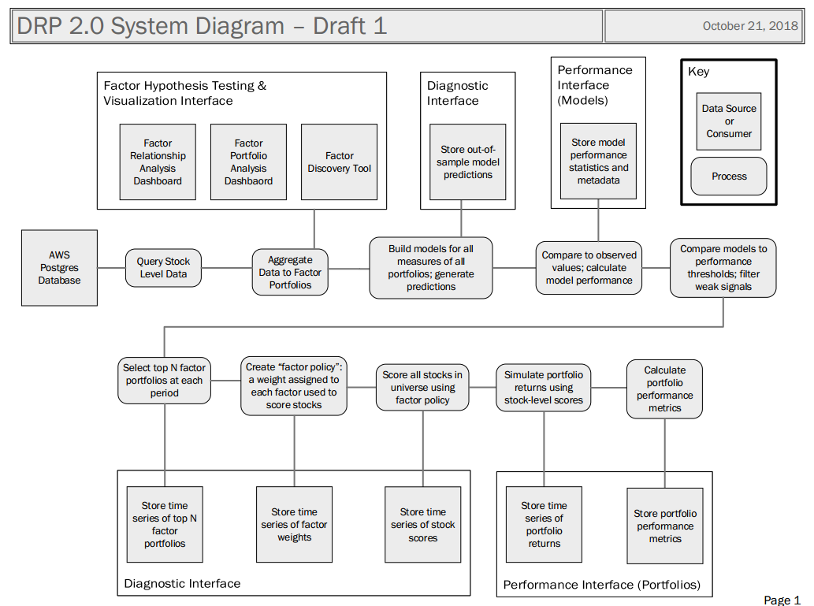
System Block Diagram
Notes:
Talk about how cluttered this is, took us a while to understand everything on it: ~30 seconds

Slide 14
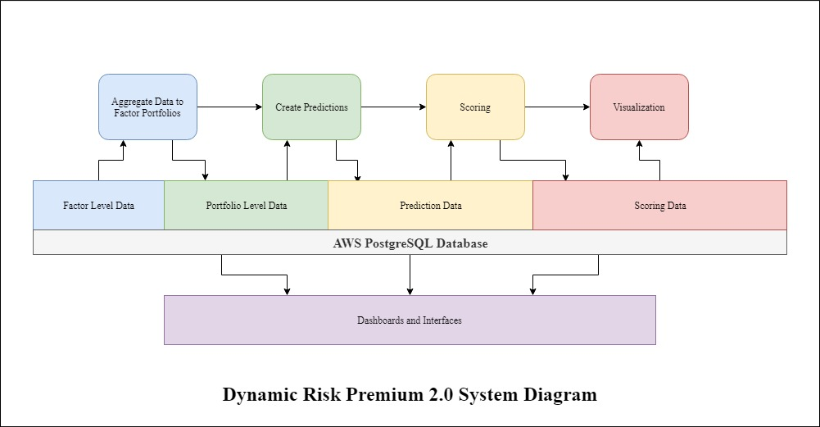
System Block Diagram
Notes:
Go a little more in depth here on the modules of the system, and how they fit together: ~40 seconds

Slide 15
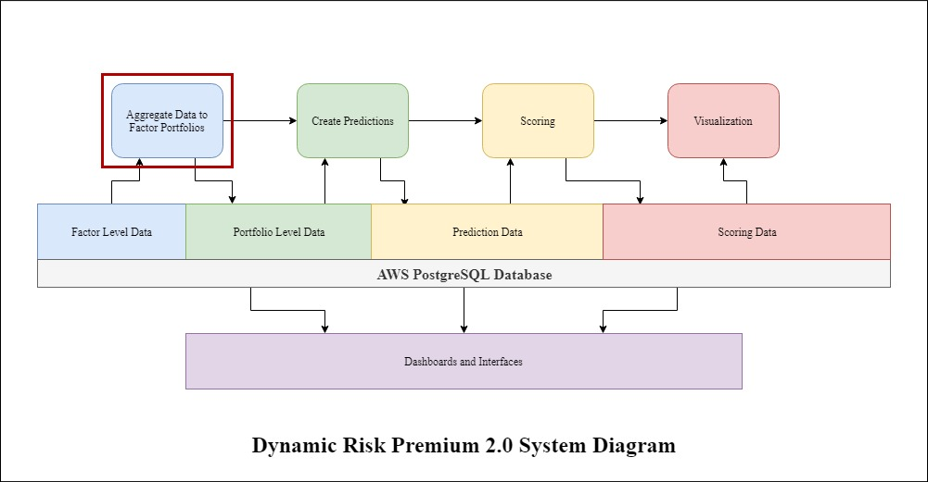
Aggregation
Notes:
Intro to aggregation: ~10 seconds

Slide 16
Factor Portfolio Aggregation
Raw Stock Level Data
(Processing)
Aggregated Factor Portfolios
Notes:
Stages of aggregation: ~30 seconds

Slide 17
Factor Portfolio Aggregation
Raw Stock level Data
(Processing)
Aggregated Factor Portfolios
date | ticker | sales_g | mcap
08-21-2015 | AAPL | 25.930147 | 603119.94
 | ABBV | 8.972895 | 104983.71
 | ⋮ | ⋮ | ⋮
 | ZTS | 4.312786 | 22462.459
08-28-2015 | AAPL | 25.930147 | 646061.4
⋮ | ⋮ | ⋮ | ⋮
05-10-2019 | ZTS | 11.236173 | 45820.613
date | factor | ⋯ | aggregated return
08-21-2015 | sales_g | ⋯ | 2.509556
 | mcap | ⋯ | 0.066887
08-28-2015 | sales_g | ⋯ | -7.881269
 | mcap | ⋯ | -1.762554
⋮ | ⋮ | ⋯ | ⋮
05-10-2019 | mcap | ⋯ | 4.176405
Notes:
Example of aggregation: ~30 seconds

Slide 18
Factor Portfolio Aggregation
Notes:
Predictions breakdown: ~1 minute

Slide 19
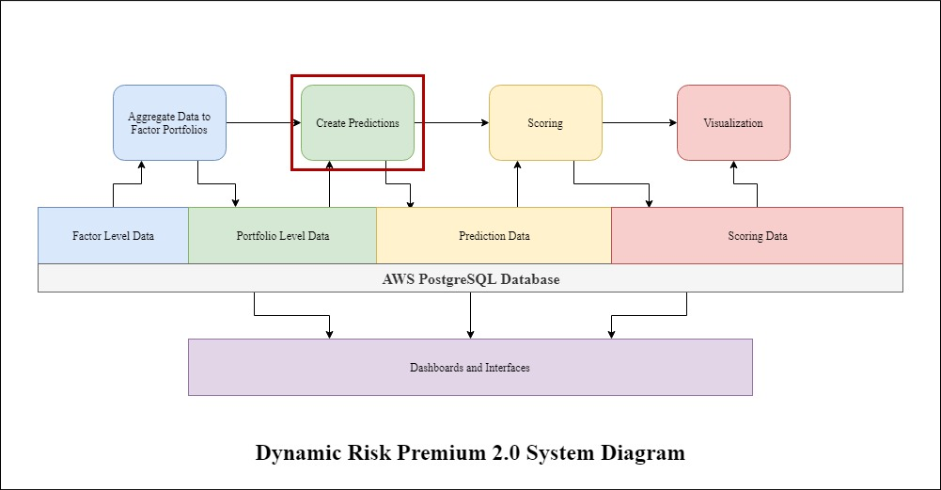
Predictions
Notes:
Transition: ~ 10 seconds

Slide 20
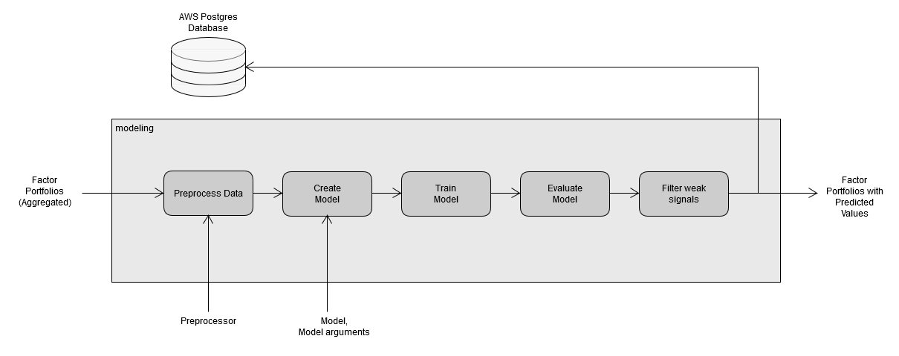
Predictions
Notes:
Predictions breakdown: ~1 minute

Slide 21
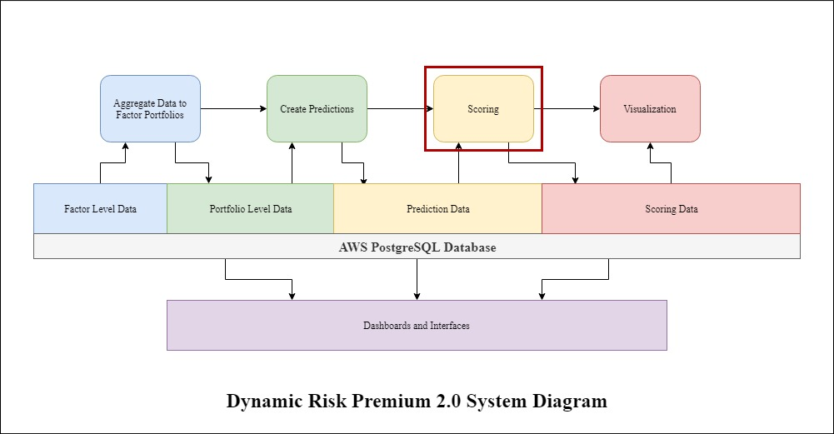
Scoring
Notes:
Transition: ~ 10 seconds

Slide 22
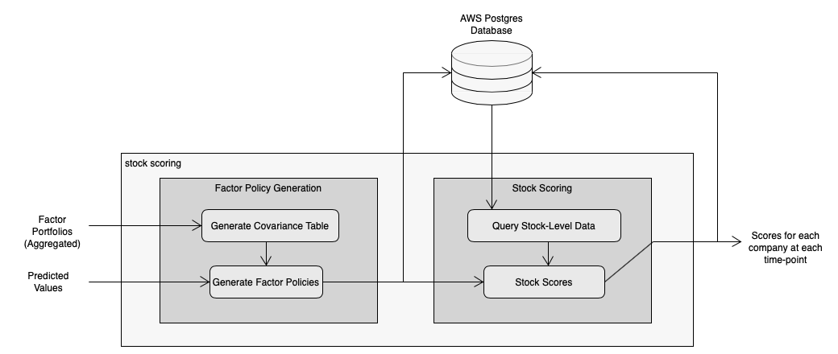
Scoring
Factor Policy Generation
Abstract Class Implemented by the user
Takes in Factor Portfolio objects and Predicted Values
Generates a weight value for each factor
Our team created a sample implementation for testing
Stock Scoring
Abstract Class implemented by the user
Takes in a table of weights created by the previous step
Queries the entire universe of data to score stocks base on the weights
Outputs a score for each stock between 0 and 1
Notes:
There is a lot here so maybe a little more time: ~1.5 minutes

Slide 23
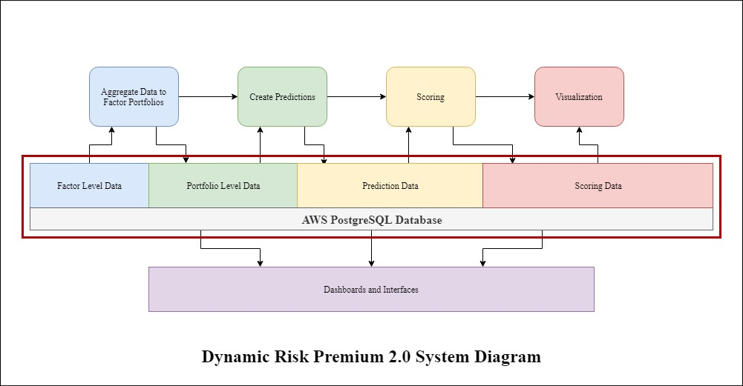
Database
Notes:
Transition: ~10 seconds

Slide 24
Database
Aggregation
Predictions
Scoring
Visualization
fp_reference
fp_parameters
fp_data
models_output
scores_reference
factor_policies
stock_scores
fp_dataset_mv
fp_spreads_mv
fp_snapshot_mv
Materialized Views
Tables
Tables
Tables
PostgreSQL Database
All data used and created is stored to the database
All queries are handled autonomously within the pipeline
Materialized Views are used to compile data from multiple tables for use by visualization dashboards
The schema we have developed is well documented and accessible
Notes:
I kinda like this slide: ~1 minute

Slide 25
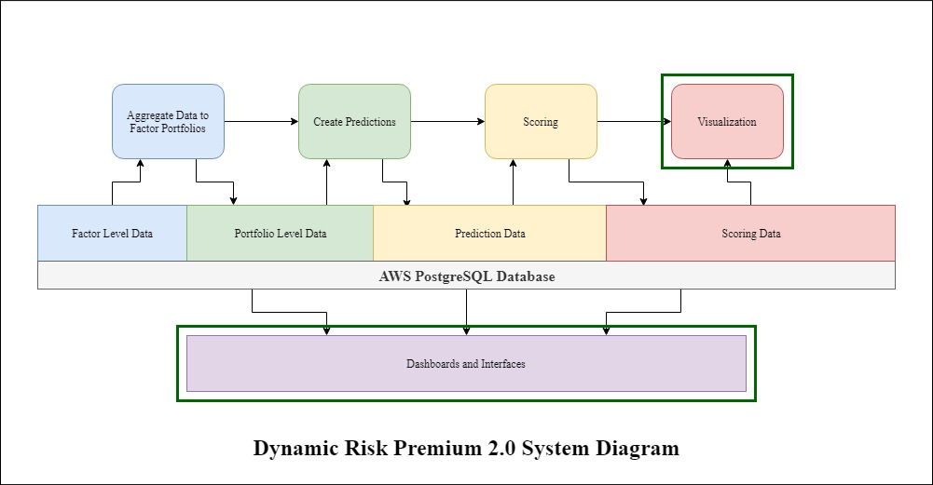
System Block Diagram
Notes:
Talk about how these are externally implemented: ~30 seconds

Slide 26
Integration
Format data
Postprocess model
Visualize results
Preprocess data
Construct models
Each module is fully functional on its own
To integrate modules into a complete pipeline a standard interface needed to be established between each module
Data is passed locally between steps in the form of pandas data frames
This allows us to avoid waiting for the long database calls
Data is passed to external modules, such as the dashboards, through materialized views
Notes:
Integration jazz: ~40 seconds

Slide 27
Technologies
Technology | Rational
PostgreSQL | Well documented, open source software available, familiarity with SQL from previous projects
AWS server | Principal was already utilizing an AWS server, allows for easy remote access, easily scaled as the needs expand
Python | Increasingly common in data science projects, very flexible and powerful, our team had some prior experience in python programming, more practical than R
Notes:
Techno, speed through this guy: ~20 seconds

Slide 28
Requirements
System Design
Agenda
Testing & Verification
Conclusion
28
Notes:
Transition: ~10 seconds

Slide 29
Test Plan
Overview
Functional
Non-functional
Unit tests check for correctness of output from the each module.
Continuous Integration tests check newly developed code for runtime issues
Constant feedback from data scientists at Principal to address errors in functionality
Performed benchmarking for the database interactions and aggregation process
Classification: Company Confidential
Notes:
Overview of how we decided on the tests we used: ~40 seconds

Slide 30
Test Plan
Unit & Integration Tests
Unit Tests
Integration Tests
We developed unit tests for each module of the pipeline:
Aggregation
Predictions
Scoring
Tested many of the possible cases within each module
Acquired a server from ETG that we used to run automated tests from our Gitlab
Allowed for us to prevent merges that would break previously implemented modules
Classification: Company Confidential
Notes:
Breakdown of two types of tests: ~ 40 seconds

Slide 31
Test Plan
Interface & User Testing
Interface Testing
User Testing
Once each module was adequately tested, we tested the interfaces between them
Checked for data mismatch and loss
Had to go back and redefine many of the interfaces
We presented our code to our client both as individual modules and as a complete package
We received feedback on the modules as we developed
Client was able to use the package without any major concerns
Classification: Company Confidential

Slide 32
Results
Test | Results
Unit | At this point, each module of the pipeline passes all of the unit tests we have performed.
Integration | Our integration tests are actively being run on the server, and will be given to Principal for their use as they continue to develop this pipeline
Interface | The issues found by our interface tests have been resolved and we no longer have any data mismatch or loss within our interfaces
User | Our contacts at Principal have not yet been able to give feedback on the pipeline as a whole, so we do not have conclusive results in this area
Notes:
Breeze through this guy: ~20 seconds

Slide 33
Validation & Verification
Client Expectation | Current Status | Met?
Increased Transparency | The data created in each step is stored within the database and a few views have been created to help visualize the DRP process at each stage of the pipeline | Yes
Modularity | Each stage of the pipeline can be ran completely independent of the other modules. This allows for future development to be done easily and efficiently | Yes
Standardized Aggregation | The aggregation process has been compiled into one standard process, but it is not as efficient as some of Principal’s current processes | Mostly
Maintainability | We have worked to create documentation at each stage of the process so that our client can easily understand the structure of the code and continue to develop the DRP 2.0 pipeline | Yes
Notes:
Spend a little more time on this one, it is much more informative: ~1.5 minutes

Slide 34
Requirements
System Design
Agenda
Testing & Verification
Conclusion
34
Notes:
Transition: ~10 seconds

Slide 35
Potential Risks & Mitigation
Team members being overloaded with other course work
SIGNIFICANT
The modules of the project do not integrate successfully
MODERATE
Significant misunderstandings of DRP 2.0 requirements
HIGHEST
Mitigation Strategy:
Active feedback with Principal throughout development
Mitigation Strategy:
Reshuffle work
Work modularly to prevent roadblocks
Mitigation Strategy:
Continuous Integration tests
Clear team communication
Notes:
Not much here, zoom through this: ~30 seconds

Slide 36
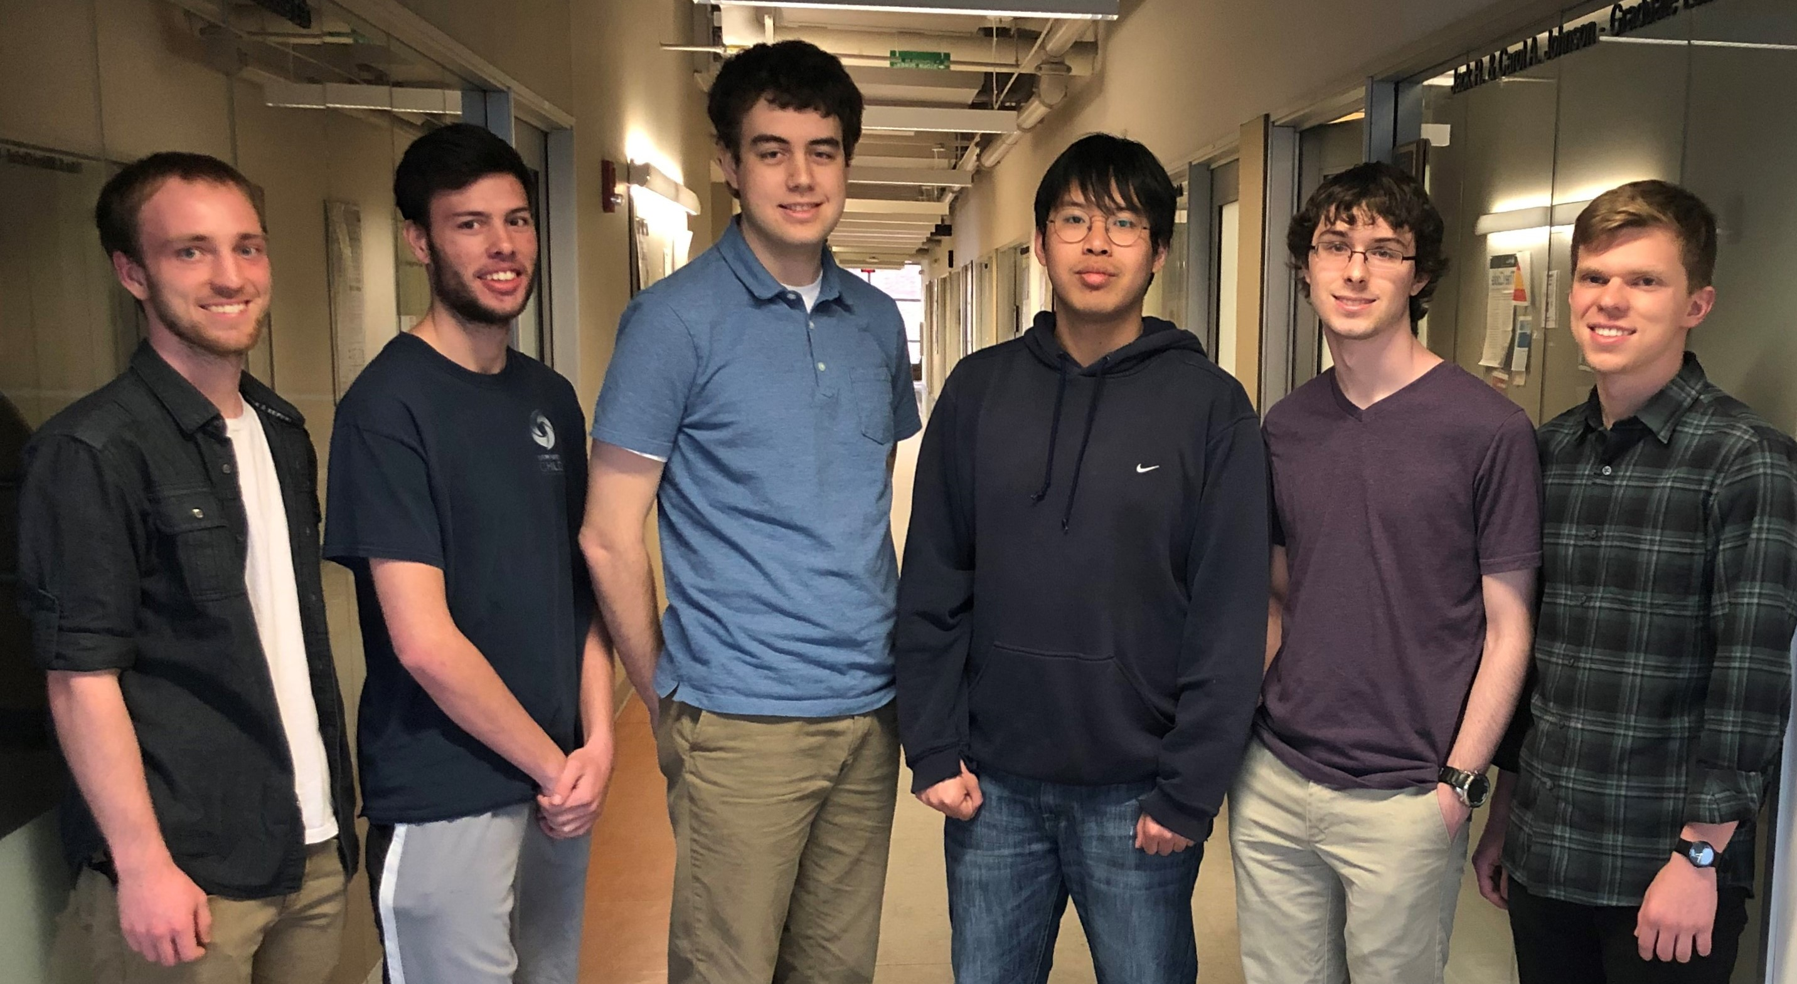
Roles & Responsibilities
Drake
Doh Yun
Communications Manager
Factor Policy & Stock Scoring
Pipeline Integration
Meeting Scribe
Modeling and Predictions
Established predictions interface with database
Jacob
Gabe
Quality Assurance Manager
Continuous Integration with Gitlab
Database interface with Dashboards
Report Manager
Factor Portfolio Aggregation
Unit Testing
Pipeline Optimization
Nathan
Josiah
Overseer of Work
Stock Scoring
Python Packaging Process
Meeting Facilitator
Created all meeting, presentation, and demo material
Database set up and interface between the pipeline and the database
Notes:
Individual roles: ~1 minute

Slide 37
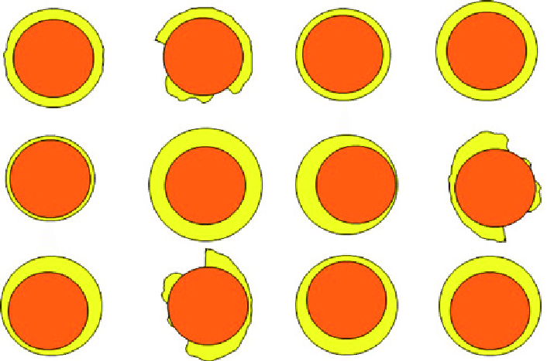
Future Work
Continue Interface with Dashboards
Optimize Aggregation Step
Standardize Data Format
Notes:
Future options for places to improve, talk about how some interns are continuing our project this summer: ~1 minute

Slide 38
Lessons Learned
Communication is KEY
Constant feedback helped prevent design mistakes from ruining our project
The client doesn’t always know what they want until they see it
Teamwork makes the dream work
We were much more productive when everyone was being held accountable to making steady progress
Have reasonable expectations
We had very little knowledge about data science coming in
It took longer for us to get comfortable with the project than we expected
Notes:
Who knows: ~30 seconds

Slide 39
Thank You – Questions?
39
Classification: Company Confidential
Notes:
Keep your final slide simple.

Slide 40
Functional Decomposition
Format data
Postprocess model
Visualize results
Preprocess data
Construct models
Pipeline Stages | How it Works | Our Task
Retrieve and Format Data | Data is retrieved from the Principal database and filtered by a combination of factors and variables. | Create a set of Library functions to query the database
Preprocess Data for the Model | Data is aggregated to factor portfolios | Create portfolios using user inputted factors.
Construct Predictive Models | Build models for all measures of all portfolios and generate predictions. | Create a software placeholder that can run models
Postprocess the Model | Models are compared and performance is calculated. Top models are compared and portfolios are selected. | Create a process to compare models to performance thresholds
Visualize the Results | The results at each stage of the pipeline is displayed through interfaces and PowerBI dashboards | Create hooks and standards for displaying data
Notes:
This slide could stay or go, its up to whoever is presenting: ~1 minute

